Slide 1



STATE LEVEL SMART HACKATHON 2025
TITLE PAGE
• Problem Statement ID - 5
• Problem Statement Title - Smart Agricultural Solutions for Hilly Terrain
STATE LEVEL
Team Name –Cobra Tech
SMART HACKATHON
-"2025“-

Slide 2

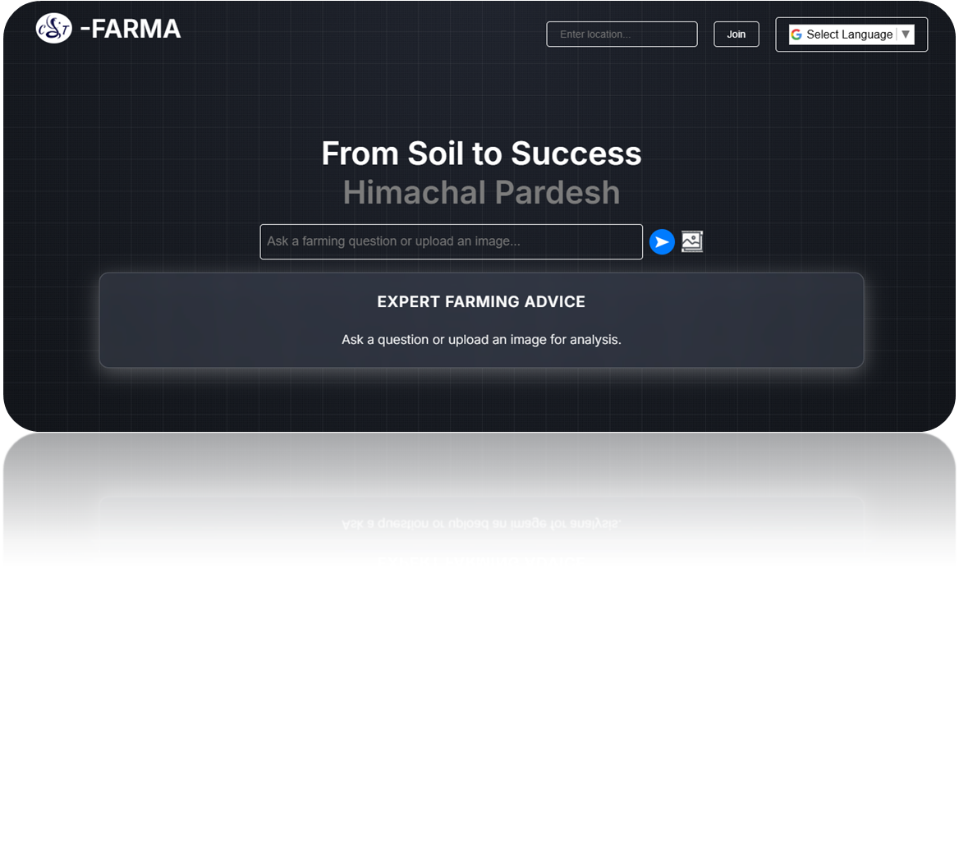
Cobra Tech
PROPOSED SOLUTION
CT-Farma: A web-based smart agricultural system tailored for hilly regions.
Features:
- AI/ML-based plant & soil analysis
- Real-time weather updates
- Market prices & agriculture news
- Interactive Q&A with AI
- Smart farming tools
-Latest Agriculture News
Innovation:
- AI-powered advisory for farmers
- Custom tools for hilly terrain
- Real-time data & machine learning integration
@SLSH Idea submission- Template
2

Slide 3
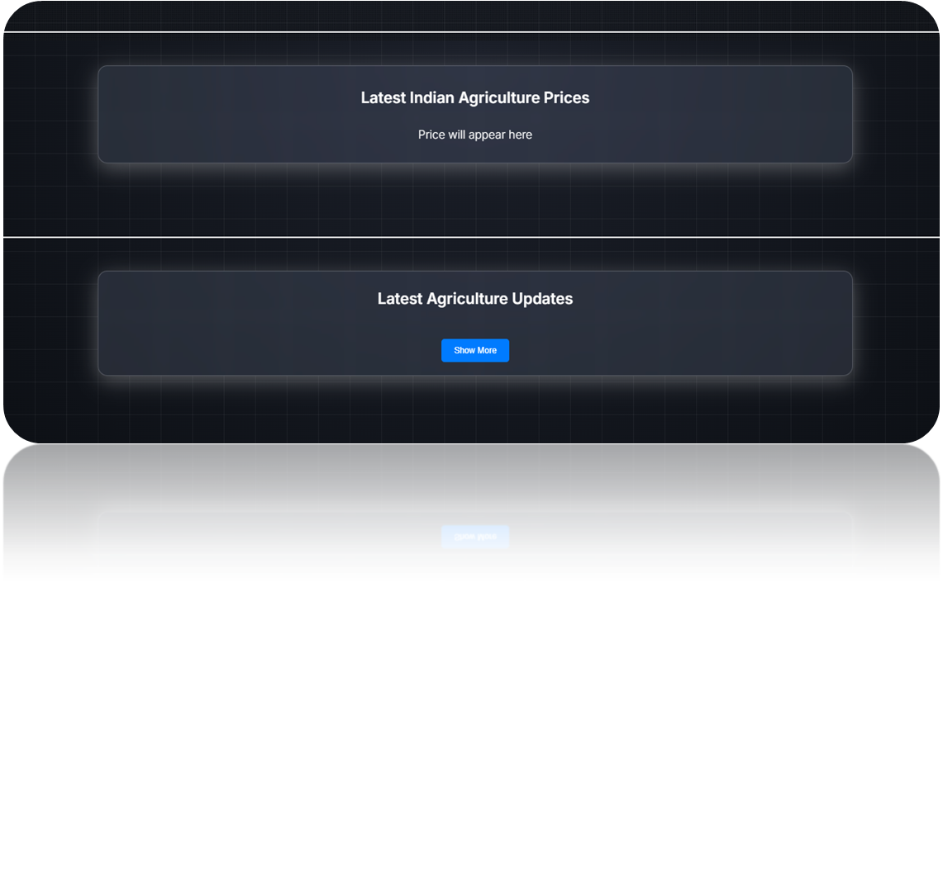
Cobra Tech
TECHNICAL APPROACH
Technologies Used:
- Frontend: HTML, CSS, JavaScript
- Backend: Flask (Python), APIs
- APIs: OpenWeather API, PlantNet API, Mistral AI
- ML: Pre-trained plant recognition models
Process Flow:
1. User inputs query/image
2. AI processes input
3. UI displays insights
@SLSH Idea submission- Template
3

Slide 4
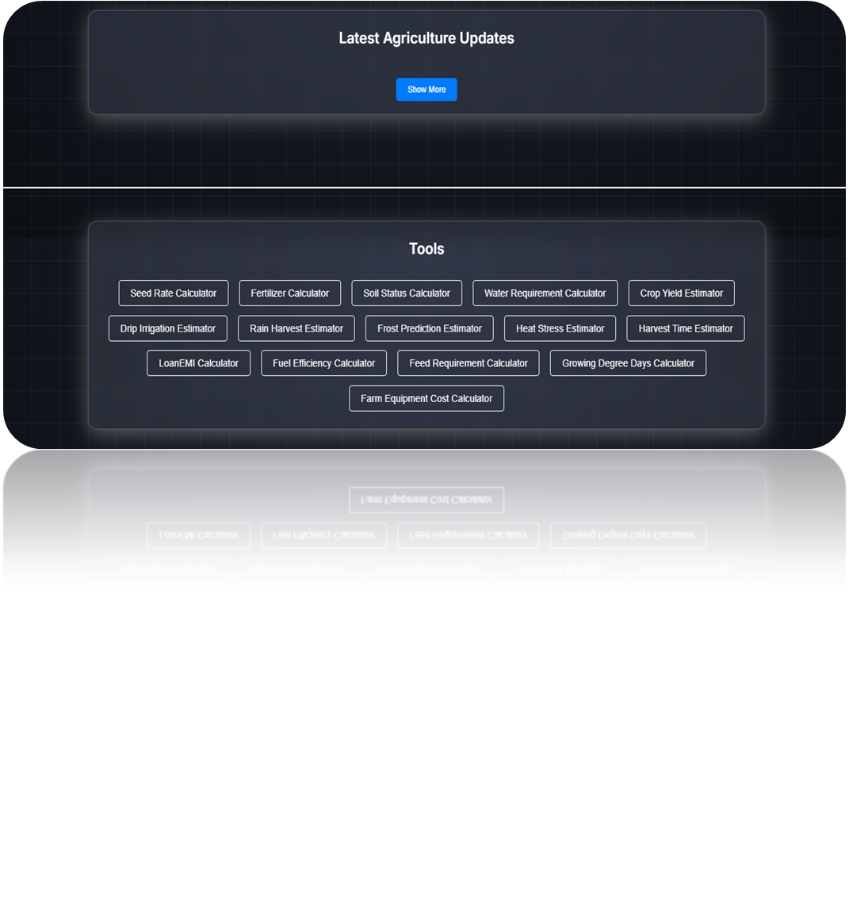
Cobra Tech
FEASIBILITY AND VIABILITY
Challenges:
- Farmers' adaptation to technology
- Data accuracy issues
Solutions:
- User-friendly interface with regional languages
- Continuous AI model improvement
-Allow multiple organ recognition like-
(leaf, flower, fruit).
@SLSH Idea submission- Template
4

Slide 5
Cobra Tech
IMPACT AND BENEFITS
Target Users:
-Farmers in hilly regions of Himachal Pradesh
Economic Benefits:
- Optimized crop yield
- Real-time market prices
Social Benefits:
- Knowledge empowerment
- Adoption of modern techniques
Environmental Benefits:
- Data-driven irrigation & fertilization
- Reduced soil degradation & water wastage
@SLSH Idea submission- Template
5

Slide 6
Cobra Tech
RESEARCH AND REFERENCES
Data Sources:
- Government agricultural databases
- OpenWeather API
- PlantNet for plant recognition
-Agriculture News
@SLSH Idea submission- Template
6

